Slide 1
FINAL PROJECT
PNEUMONIA DETECTION
AMIRTHAA B
PSG Institute of Technology and Applied Research
B.E. Computer Science and Engineering
NM id: au715521104003
Email: baskaranamirthaa@gmail.com
3/21/2024 Annual Review

Slide 2
PROJECT TITLE
Title: Pneumonia detection system
Description : The project is centered around harnessing the capabilities of deep learning, particularly Convolutional Neural Networks (CNNs), to detect pneumonia from chest X-ray images. This initiative aims to aid healthcare professionals in the early diagnosis and treatment of pneumonia, thereby improving patient outcomes. By utilizing CNNs and image processing techniques, the system can analyze chest X-ray images and accurately identify signs of pneumonia. This approach enables rapid and automated screening of patients, potentially reducing diagnosis time and improving overall healthcare efficiency. With the increasing demand for reliable and efficient medical diagnostics, leveraging CNNs for pneumonia detection represents a significant step forward in enhancing healthcare services.
3/21/2024 Annual Review

Slide 3


AGENDA
Problem Statement
Project overview
End Users
Proposed solution
Algorithm & Deployment
Modelling
Result
3/21/2024 Annual Review

Slide 4

PROBLEM STATEMENT
Pneumonia remains a significant cause of morbidity and mortality worldwide, necessitating timely and accurate diagnosis for effective treatment.
Current diagnostic processes, particularly the interpretation of chest X-ray images, are labor-intensive, time-consuming, and prone to human error.
The project aims to develop a pneumonia detection system using Convolutional Neural Networks (CNNs) and advanced image processing techniques to automate and enhance the accuracy of pneumonia diagnosis from chest X-ray images.
3/21/2024 Annual Review

Slide 5

PROJECT OVERVIEW
The project aims to develop a pneumonia detection system using Convolutional Neural Networks (CNNs) and advanced image processing techniques.
Leveraging a dataset of chest X-ray images, the system employs a CNN architecture with multiple convolutional and pooling layers for feature extraction and classification.
By training the model on a dataset comprising both normal and pneumonia-infected chest X-ray images, the system aims to achieve accurate diagnosis and classification of pneumonia cases.
3/21/2024 Annual Review

Slide 6

WHO ARE THE END USERS?
Healthcare Professionals: Radiologists, physicians, and healthcare workers who diagnose and treat patients with respiratory conditions, including pneumonia.
Hospitals and Clinics: Medical facilities where chest X-ray imaging is performed and where the system could assist in the interpretation and diagnosis of pneumonia cases.
Medical Researchers: Professionals involved in medical research, epidemiology, and public health who may utilize the system for studying disease patterns, treatment outcomes, and epidemiological trends related to pneumonia.
Patients: Individuals who seek medical care for respiratory symptoms and may benefit indirectly from improved diagnostic accuracy and timely treatment facilitated by the system.
3/21/2024 Annual Review

Slide 7

YOUR SOLUTION AND ITS VALUE PROPOSITION
Accurate Diagnosis:This accuracy ensures that patients receive timely and appropriate treatment, leading to improved health outcomes.
Time Efficiency: Healthcare professionals can make faster decisions, leading to expedited treatment and improved patient care.
Scalability and Accessibility: The system can be implemented in various healthcare settings, including hospitals, clinics, and diagnostic centers.
Resource Optimization: This efficiency leads to cost savings and improved operational workflows within healthcare organizations.
Enhanced Patient Care: With quicker and more accurate diagnosis of pneumonia, patients can receive timely treatment, leading to better management of their condition and potentially reducing the severity of complications associated with pneumonia.
3/21/2024 Annual Review

Slide 8

THE WOW IN YOUR SOLUTION
The "wow" factor in our solution lies in its revolutionary approach to pneumonia diagnosis and management, driven by cutting-edge technology and innovation. Through the pioneering use of convolutional neural networks (CNNs), our system can analyze chest X-ray images with unprecedented accuracy, enabling rapid and precise identification of pneumonia. This capability holds immense potential for healthcare providers, offering the ability to swiftly diagnose pneumonia, initiate timely interventions, and ultimately improve patient outcomes. Moreover, our solution is designed for accessibility and scalability, making it suitable for deployment across diverse healthcare settings, from bustling urban hospitals to remote clinics in underserved regions. By automating the pneumonia detection process, our system empowers healthcare professionals with advanced diagnostic capabilities, allowing them to focus their expertise on more complex cases and deliver higher quality care. Ultimately, our solution promises to transform the landscape of pneumonia diagnosis and management, setting new standards for healthcare excellence and significantly impacting patient care.
3/21/2024 Annual Review

Slide 9
MODELLING
During training, the model is fitted using a training data generator to handle data augmentation. The number of epochs is set to 12, and learning rate reduction is applied using the ReduceLROnPlateau callback to enhance convergence. After training, the model's performance is evaluated on a separate test dataset, and metrics such as loss and accuracy are reported.
Additionally, visualizations of training and validation accuracy, as well as training and validation loss, are plotted over epochs to assess the model's learning progress. Furthermore, a classification report and confusion matrix are generated to analyze the model's performance in detail, including precision, recall, and F1-score for each class.
Lastly, sample images with their predicted and actual classes are displayed to provide a qualitative assessment of the model's performance. Overall, this phase focuses on constructing, training, and evaluating the CNN model for pneumonia detection, aiming to achieve high accuracy and robust generalization.
3/21/2024 Annual Review

Slide 10
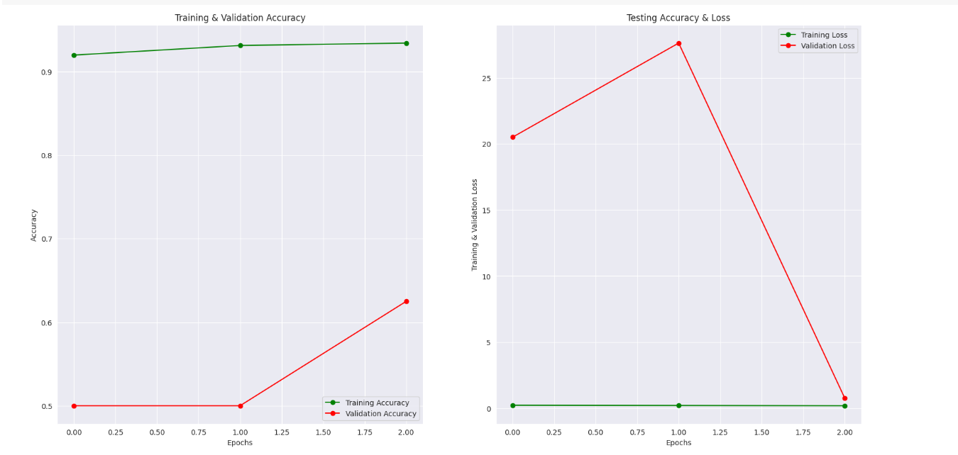
RESULTS
Demo Link
3/21/2024 Annual Review

